Slide 1
Emissions trends and drivers in IPCC AR6
Niklas Döbbeling, William Lamb & Jan Minx
APSIS seminar
9.12.2021

Slide 2
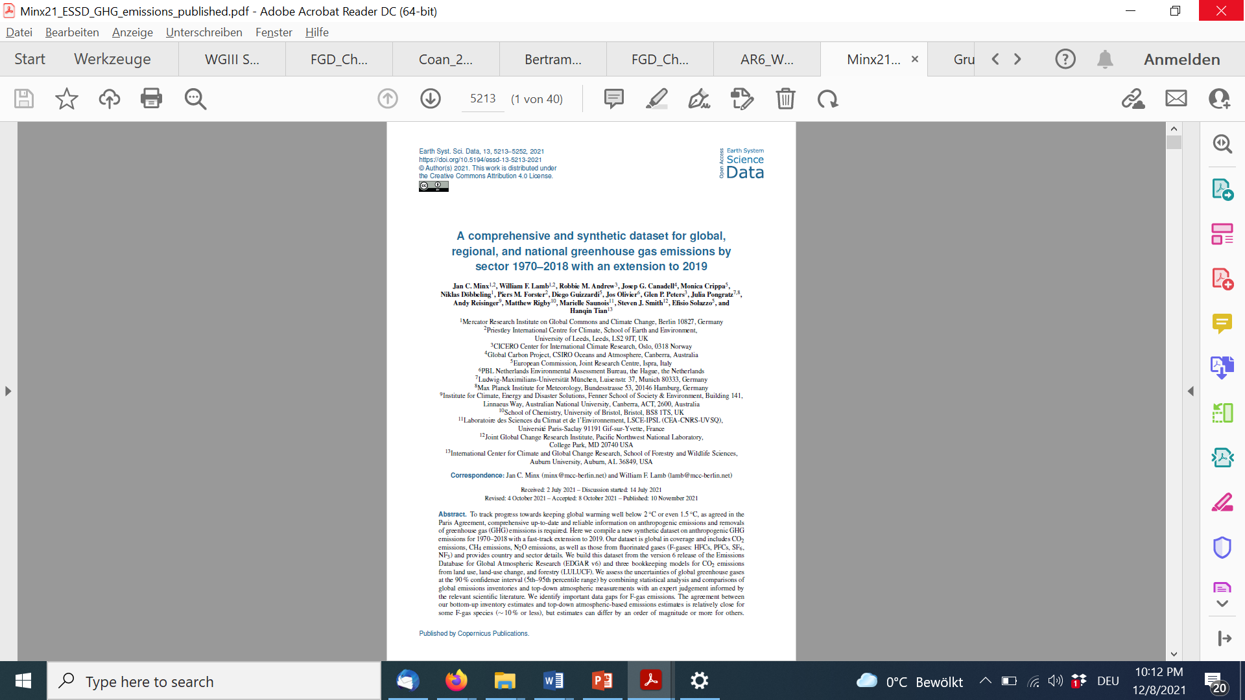
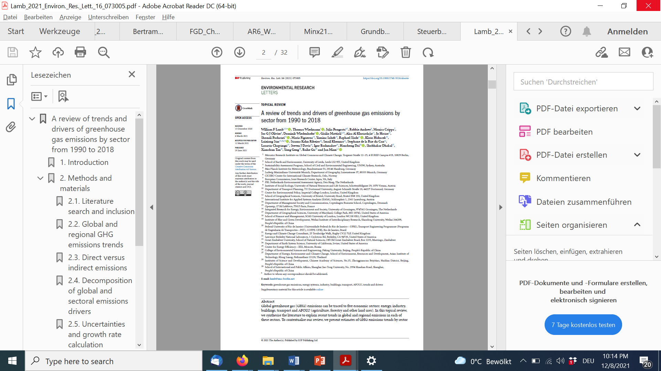
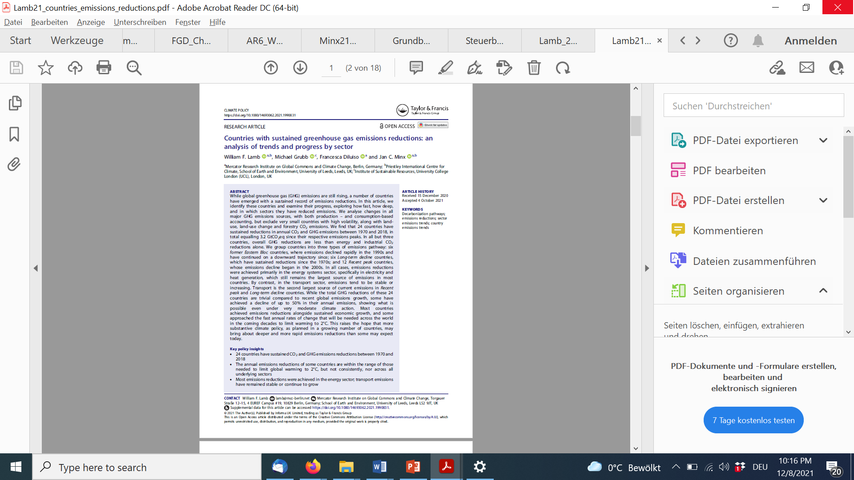
On today‘s menu

Slide 3

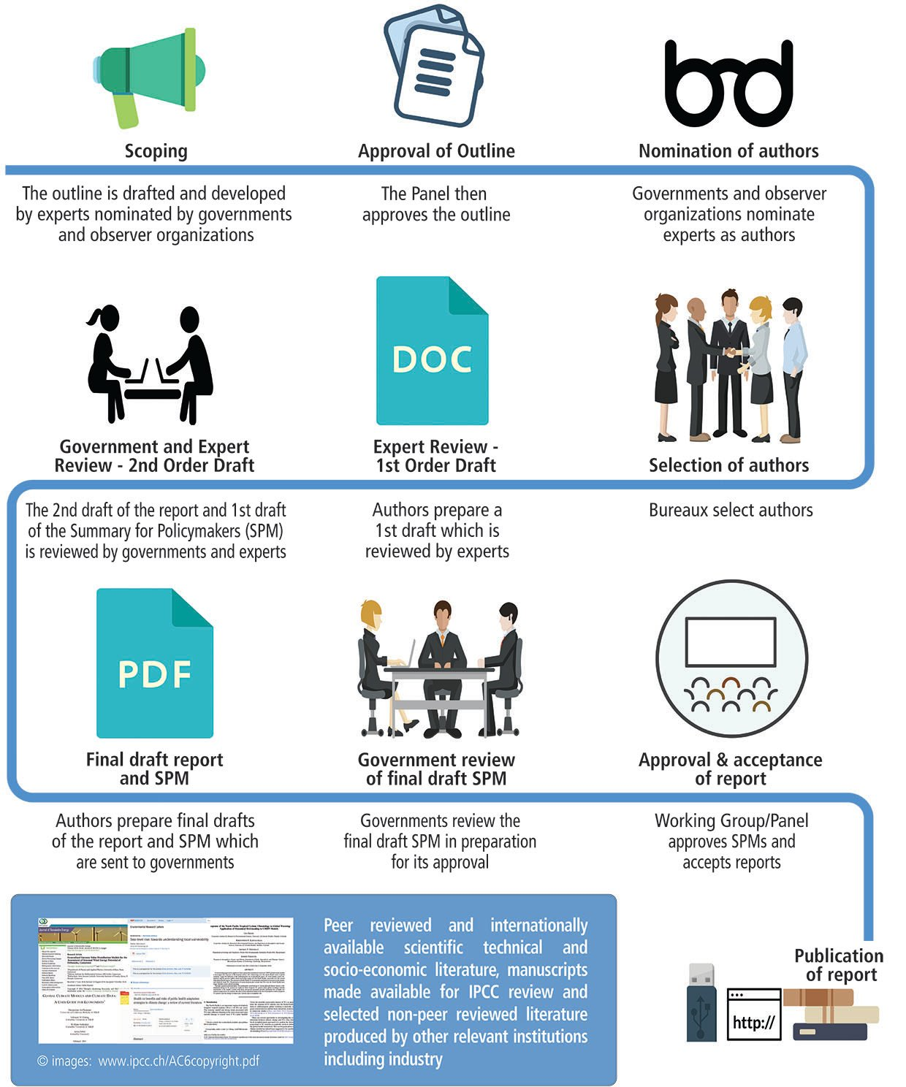
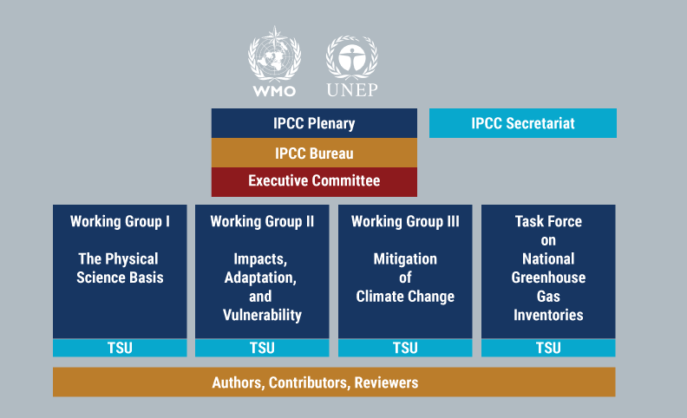
The dignity and power of IPCC assessments in international climate diplomacy

Slide 4
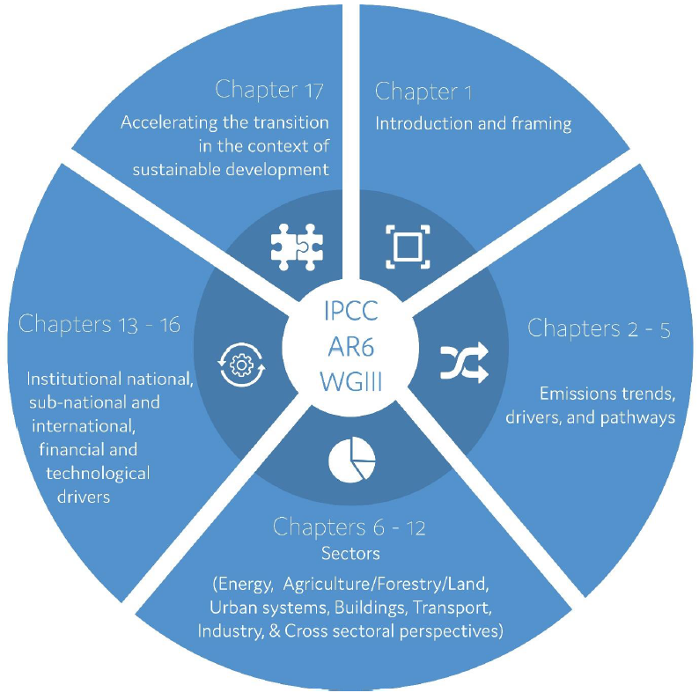
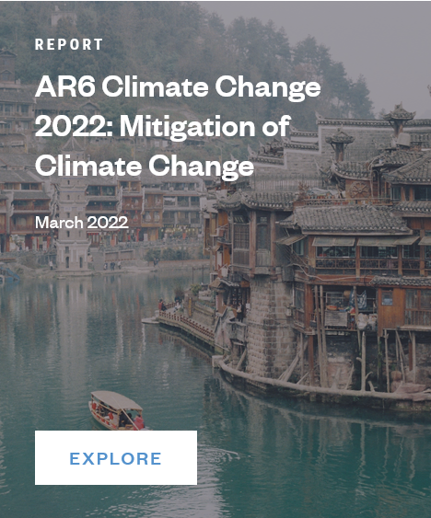
Working Group III report
Chapter 2: Emissions trends & drivers

Slide 5
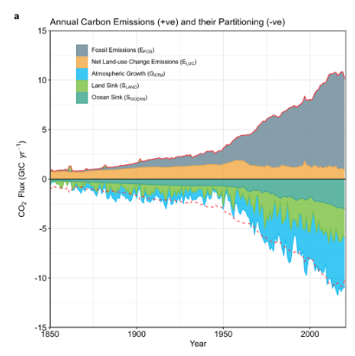
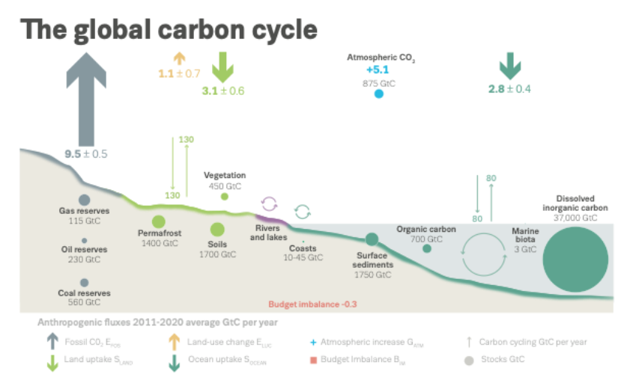
Tracking GHG emissions sounds easy, but it is not!
Friedlingstein et al. (2021), Global Carbon Budget 2021, Earth Syst. Sci. Data

Slide 6

GHG emissions accounting 101
IPCC Guidlines for National Greenhouse Gas Inventories prvode methodological guidance for the compilation of bottom-up inventories:
Tier 1: Simple default methodology, (global) emission factors and other parameters;
Tier 2: Replace default values by country-specific data data and use more detailed calculations and activity data;
Tier 3: country-specific equations für calculating emissions with more details regarding activity data, technologies and practices.
Tier 2 & Tier 3 are also called higher-tier methods

Slide 7
Tracking progress in national, regional and global GHG emissions is critical, but high-quality inventories are still quite rare
UNFCCC only imposes stringent reporting obligations for Annex-I countries and Europe:
1990 – today with 2-year reporting lag
Non-Annex I countries submit National Communications and Biennial Update Reports (BURs)
first BUR submitted should cover the inventory for the year no more than 4 years prior to the submission data, and subsequent BURs should be submitted every 2 years
Exceptions for LDCs
There should be an inventory at least after 2 years for all 197 UNFCCC countries, but there is not
>150 countries are lacking time series
We are not in a good position to track GHG emissions at a global level. Have to rely on much simpler, global GHG emissions inventories such as EDGAR, PRIMAP or CAIT
Minx, J. C. et al. A comprehensive dataset for global, regional and national greenhouse gas emissions by sector 1970-2019. Earth System Science Data (2021) doi:10.5194/essd-2021-228.

Slide 8
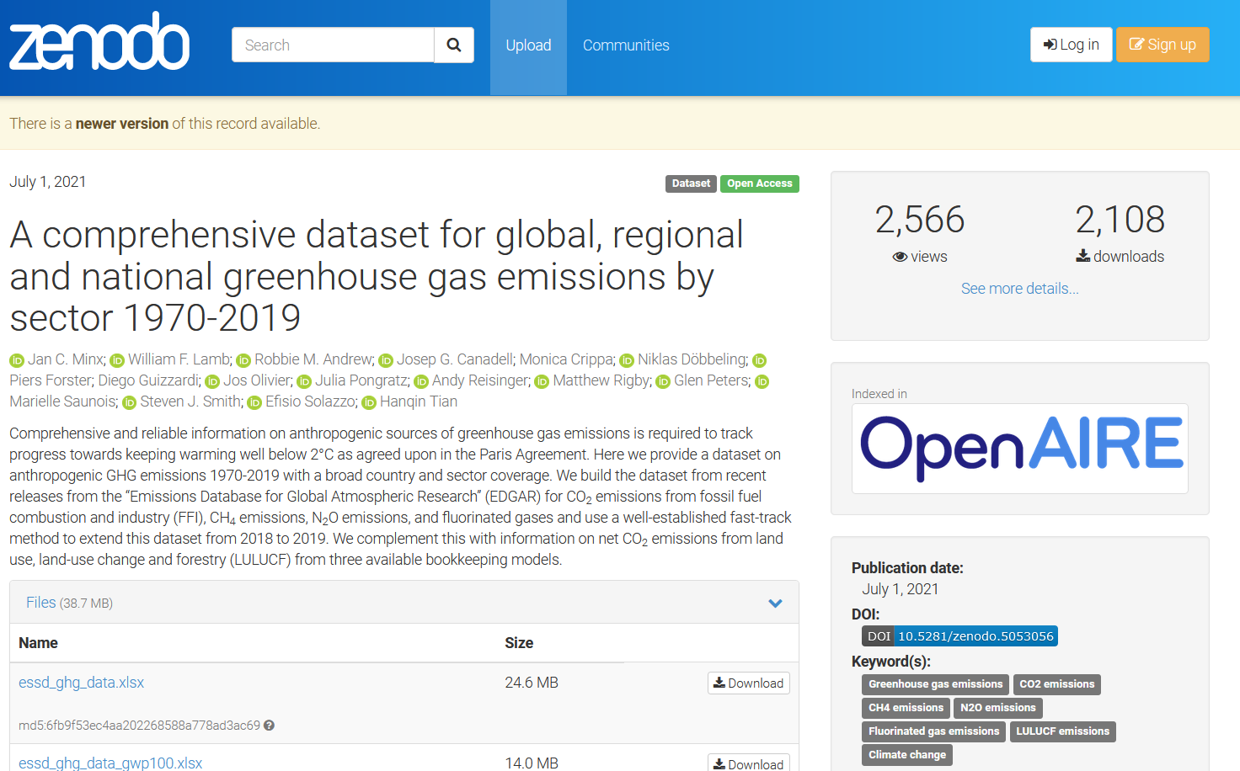
Innovation 1: For AR6 we compiled a comprehensive, synthetic, publicly available dataset on all major GHG emissions
Data Sources: EDGARv6, GCP2020
Gases covered: CO2-FFI; CO2-LULUCF; CH4, N20; F-gases (HFCs, PFCs, SF6, NH3)
5/10 regions, 228 countries
5/27 sectors
Available at: https://zenodo.org/record/5053056#.YbGNAroo82w

Slide 9
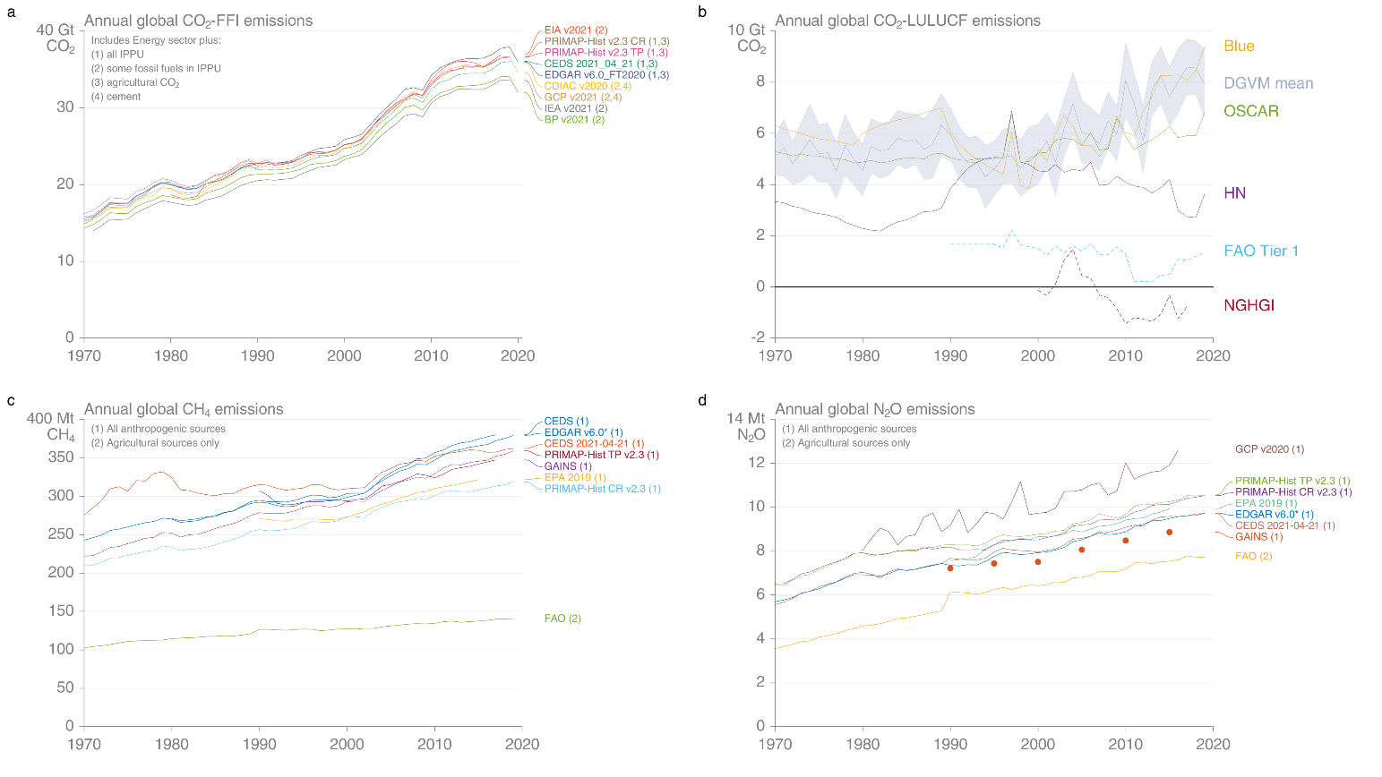
Innovation 2 – uncertainties assessment: why emission estimates differ and why they are uncertain
Uncertainties arise, because:
Processes are not sufficiently understood (scientific uncertainty)
Incomplete or unknown parameter information as well as estimation uncertainties
BUT: observed variability across datasets is not necessarily generic uncertainty.
Our approach: provide global expert judgement on uncertainties by (groups of) gases considering multiple lines of evidence:
Inventory comparisons;
Top-down/bottom-up inventory comparisons
Uncertainties literature incl. error propagation as in IPCC Guidelines
Minx, J. C. et al. A comprehensive dataset for global, regional and national greenhouse gas emissions by sector 1970-2019. Earth System Science Data (2021) doi:10.5194/essd-2021-228.

Slide 10
First comprehensive assessment of uncertainties: final judgement
We assess uncertainties for a 90% confidence interval and report our emissions estimates at 2 significant digits
Gas | AR5 | AR6
CO2-FFI | ±8% | ±8%
CO2-LULUCF | ±50 | ±70%
CH4 | ±20% | ±30%
N2O | ±70 | ±70%
F-gases | ±20 | ±30%
Minx, J. C. et al. A comprehensive dataset for global, regional and national greenhouse gas emissions by sector 1970-2019. Earth System Science Data (2021) doi:10.5194/essd-2021-228.

Slide 11
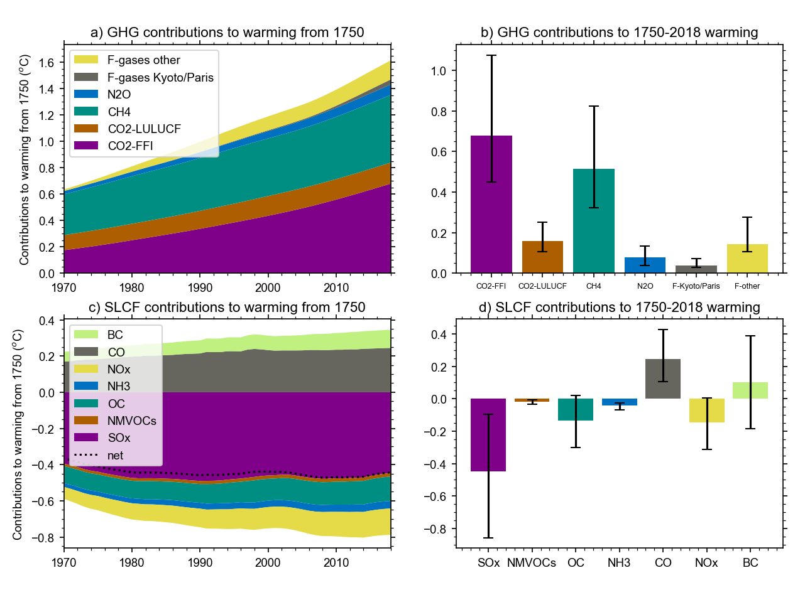
We use GWP-100 to aggregate gases
There is a whole universe of metrics to aggregate GHGs;
Metrics should be avoided whenever possible. Adequate choice depends on policy objective and context;
Our choices of GWP-100 reflects the dominant use in the scientific literature and is consistent with decisions made by Parties to the Paris Agreement for reporting and accounting of emissions and removals;
All metrics have limitations
Minx, J. C. et al. A comprehensive dataset for global, regional and national greenhouse gas emissions by sector 1970-2019. Earth System Science Data (2021) doi:10.5194/essd-2021-228.

Slide 12
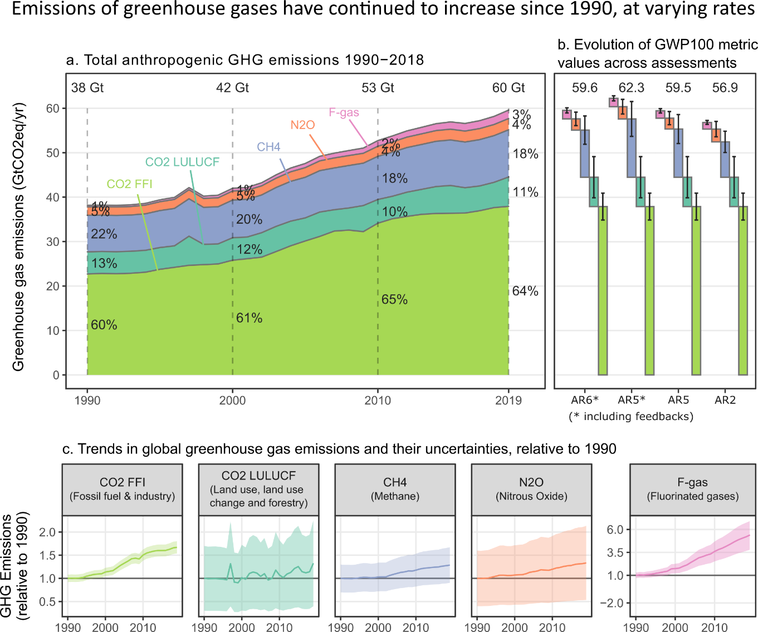
Total global net anthropogenic GHG emissions have continued to rise
Average GHG emissions during 2010–2019 were higher than in any previous decade, but the rate of growth between 2010 and 2019 was lower than that between 2000 and 2009.
Global net anthropogenic GHG emissions were 59±6.6 GtCO2-eq5 in 2019, about 12% (6.5 GtCO2-eq) higher than in 2010 and 54% (21 GtCO2-eq) higher than in 1990.
Average annual net GHG emissions during the decade 2010–2019 were 56±6.0 GtCO2-eq, 9.1 GtCO2-eq higher than in 2000-2009. This is the highest absolute decadal increase since 1850.
Average annual growth slowed from 2.1%, for 2000-2009 to 1.3% for 2010-2019.
Based on: Minx, J. C. et al. A comprehensive dataset for global, regional and national greenhouse gas emissions by sector 1970-2019. Earth System Science Data (2021) doi:10.5194/essd-2021-228.

Slide 13
Total global net anthropogenic GHG emissions have continued to rise
Emissions growth has varied, but persisted across all groups of greenhouse gases.
The average annual emission levels of the last decade (2010-2019) were higher than in any previous decade for each group of greenhouse gases.
Compared to 1990, the magnitude and speed of these increases differed across gases: CO₂ from fossil fuel and industry (FFI) grew by 15 GtCO₂eqyr⁻¹ (67%), CH₄ by GtCO₂eqyr⁻¹ (29%), F-gases by 0.97 GtCO₂eqyr⁻¹ (250%), N2O by 0.65 GtCO₂eqyr⁻¹ (33%).
CO₂ emissions from net land use, land-use change and forestry (LULUCF) have shown little long-term change, with large uncertainties preventing the detection of statistically significant trends.
Based on: Minx, J. C. et al. A comprehensive dataset for global, regional and national greenhouse gas emissions by sector 1970-2019. Earth System Science Data (2021) doi:10.5194/essd-2021-228.

Slide 14
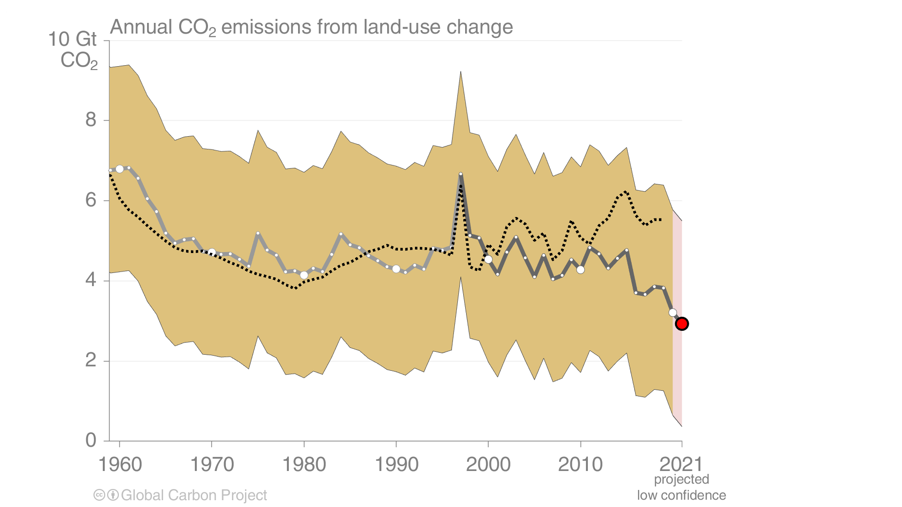
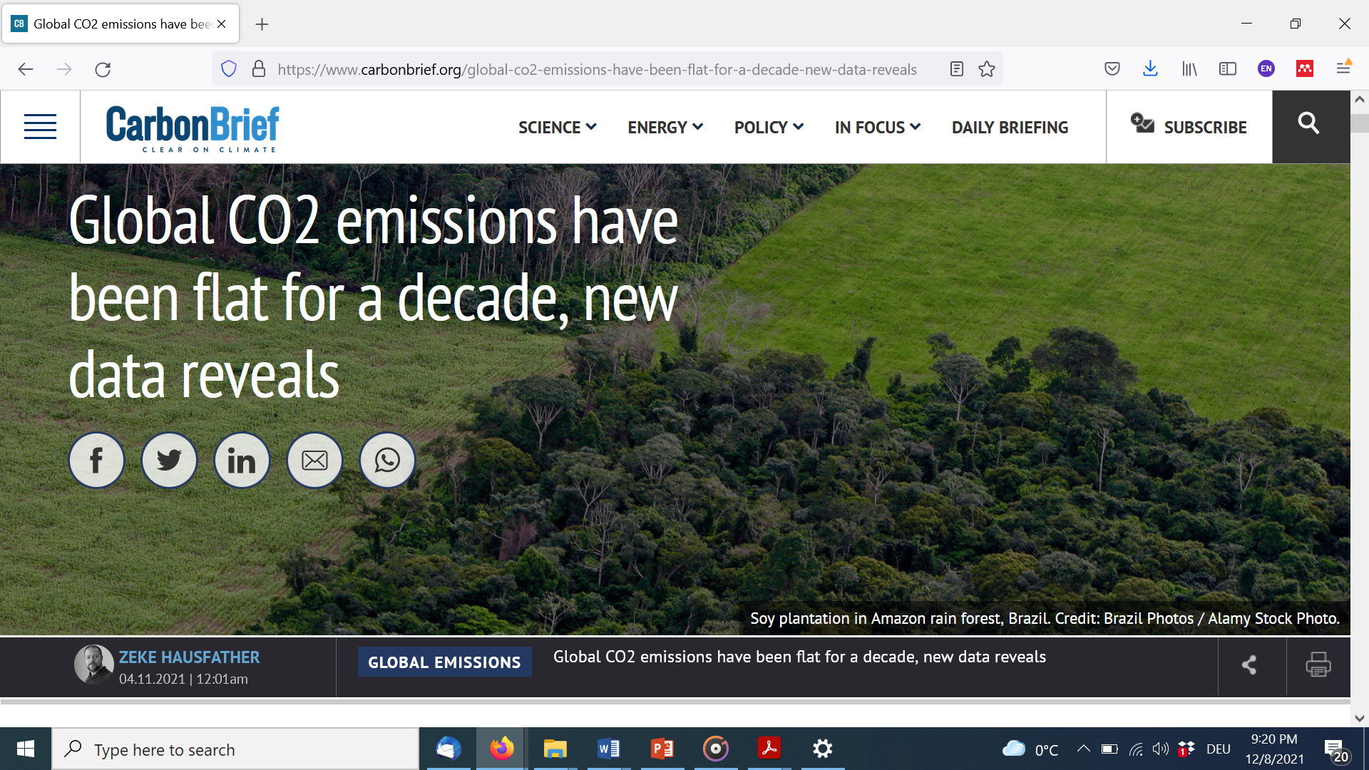
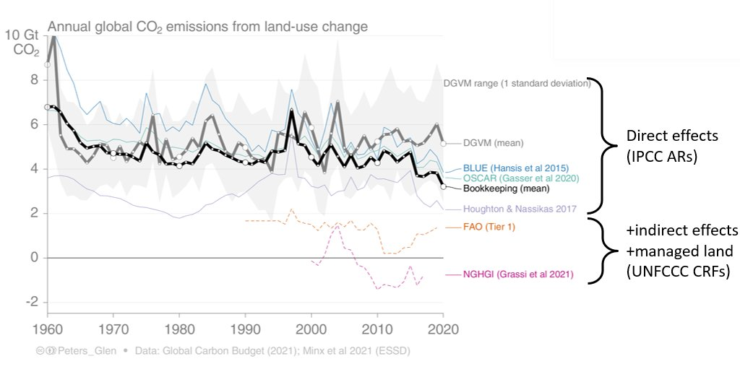
Interlude: Did CO2 emissions growth stall over the last decade?

Slide 15
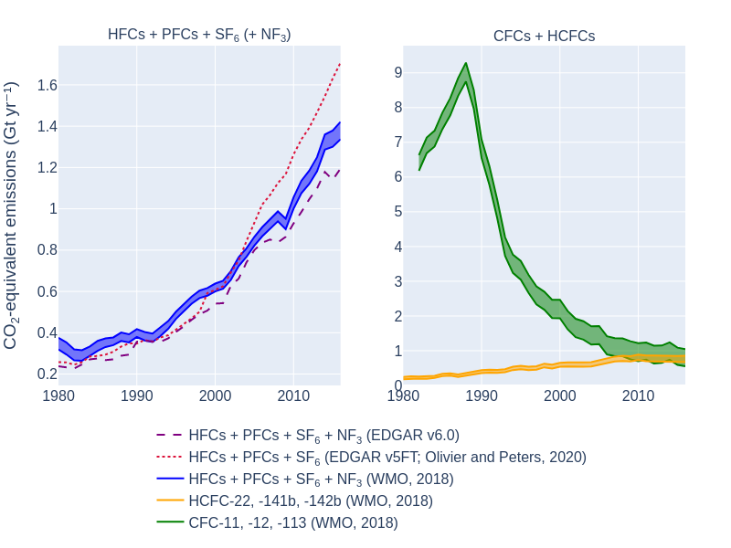
F-gases have been growing fastest and are
F-gases have grown fastest, but from a low base. But today they are no longer negligible at 1.4±0.41 GtCO2eq in 2019.
F-gases excluded from GHG emissions inventories such as chlorofluorocarbons (CFCs) and hydrochlorofluorocarbons (HCFCs) are at least the same size as those included.
Real policy devide on F-gases. We cannot be sure that Montreal regulation will deliver on net-zero.
Huge data quality issues in inventories (not from top-down).
Based on: Minx, J. C. et al. A comprehensive dataset for global, regional and national greenhouse gas emissions by sector 1970-2019. Earth System Science Data (2021) doi:10.5194/essd-2021-228.

Slide 16
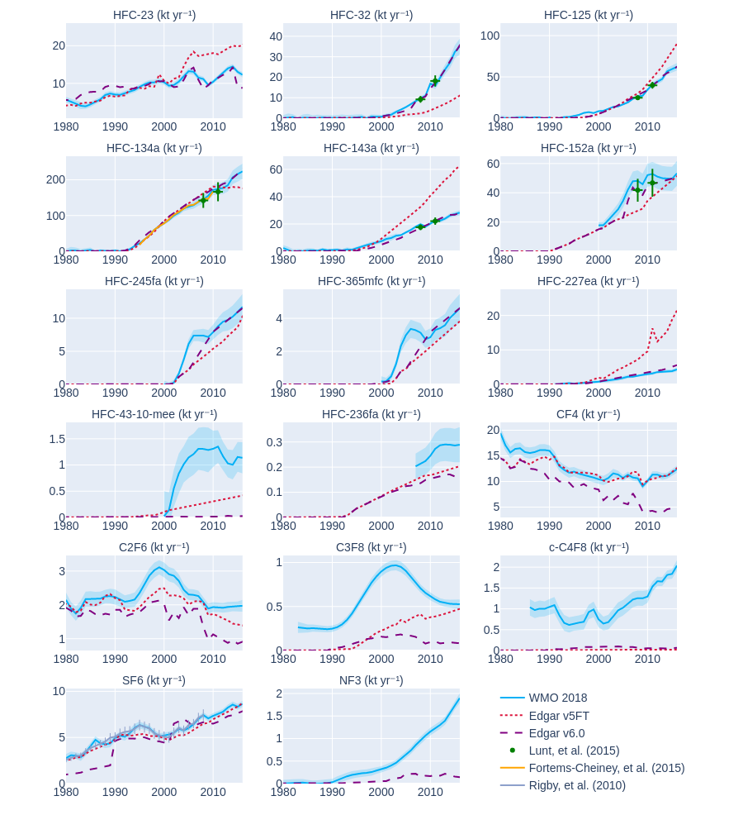
Huge data quality issues on F-gases
EDGAR estimate diverge by 10-30% fom top-down estimates depending on version.
At the species level differences can reach orders of magnitude in some case – particularly for EDGARv5FT.
Huge inventory data problem for non-Annex I countries.
Based on: Minx, J. C. et al. A comprehensive dataset for global, regional and national greenhouse gas emissions by sector 1970-2019. Earth System Science Data (2021) doi:10.5194/essd-2021-228.

Slide 17
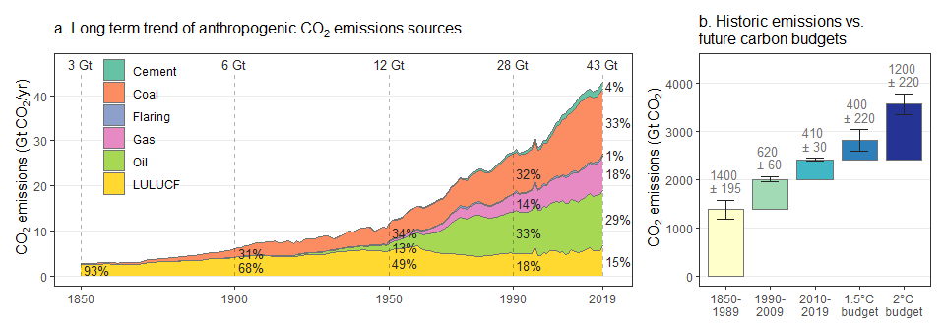
The carbon budget for keeping warming below 1.5°C with a good chance (>50%) is almost exhausted.
Cumulative net CO2 emissions of the last decade (2010-2019) are about the same size as the remaining carbon budget for keeping warming to 1.5°C
Cumulative net CO2 emissions since 1850 are increasing at an accelerating rate. 62% of total cumulative CO2 emissions from 1850 to 2019 occurred since 1970 (1500±140 GtCO2), about 43% since 1990 (1000±90 GtCO2), and about 17% since 2010 (410±30 GtCO2).
CO2 emissions of the last decade are about the same size the remaining carbon budget for keeping warming to 1.5°C with a 67% (50%): 400(500)±220 GtCO2
Note: simple ways of thinking about CO2 emission reductions, budgets and negative emissions can be more instructive than complex modelling exercises.

Slide 18
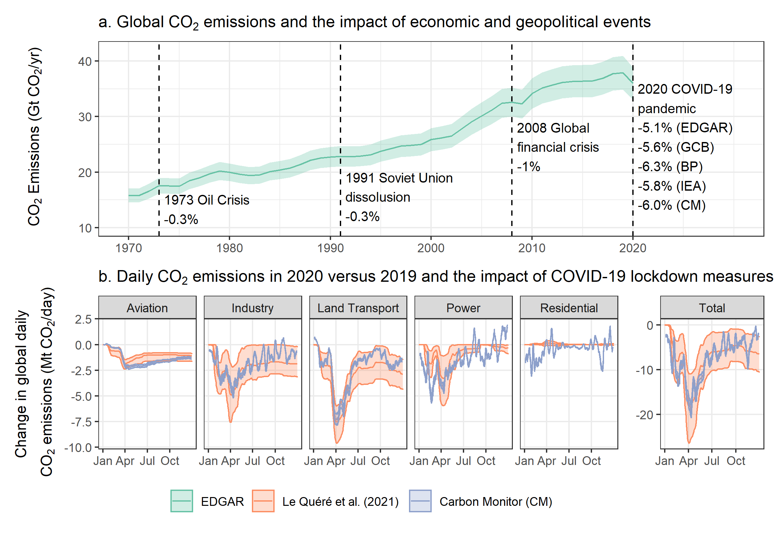
The global COVID-19 pandemic led to a steep drop in CO2 emissions from fossil fuel and industry.
Global CO2-FFI emissions dropped in 2020 by about 5.8% (5.1% – 6.3%) or about 2.2 (1.9-2.4) GtCO2 compared to 2019.
This exceeds any previous global emissions decline since 1970, both in relative and absolute terms.
Emissions, however, have rebounded globally by the end of December 2020
Approaches that predict near real-time estimates of the power sector reduction are more uncertain and estimates range more widely, between 1.8%, 4.1% and 6.8%; the latter taking into account the over-proportional reduction of coal generation due to low gas prices and merit order effects

Slide 19
Over to Will for region and sector results

Slide 20

A note on the methods
Our data, analysis and figure pipeline is open access:
https://github.com/mcc-apsis/AR6-Emissions-trends-and-drivers
Attempt to make everything fully replicable and transparent

Slide 21
Our sophisticated theoretical framing

Slide 22


Reasons to be cheerful <-> reasons to be miserable
How has the growth rate of emissions changed?
In which regions/sectors are emissions declining?
Which fossil fuels are being phased out?
…
Have emissions continued to grow overall?
In which regions/sectors are emissions rising?
What fossil fuel infrastructure is locked in for a long lifetime?
…

Slide 23

Equity and “balance”
Current emissions
Absolute emissions
Absolute growth
…
Historic emissions
Per capita emissions
Relative growth
…

Slide 24
Region emissions trends

Slide 25
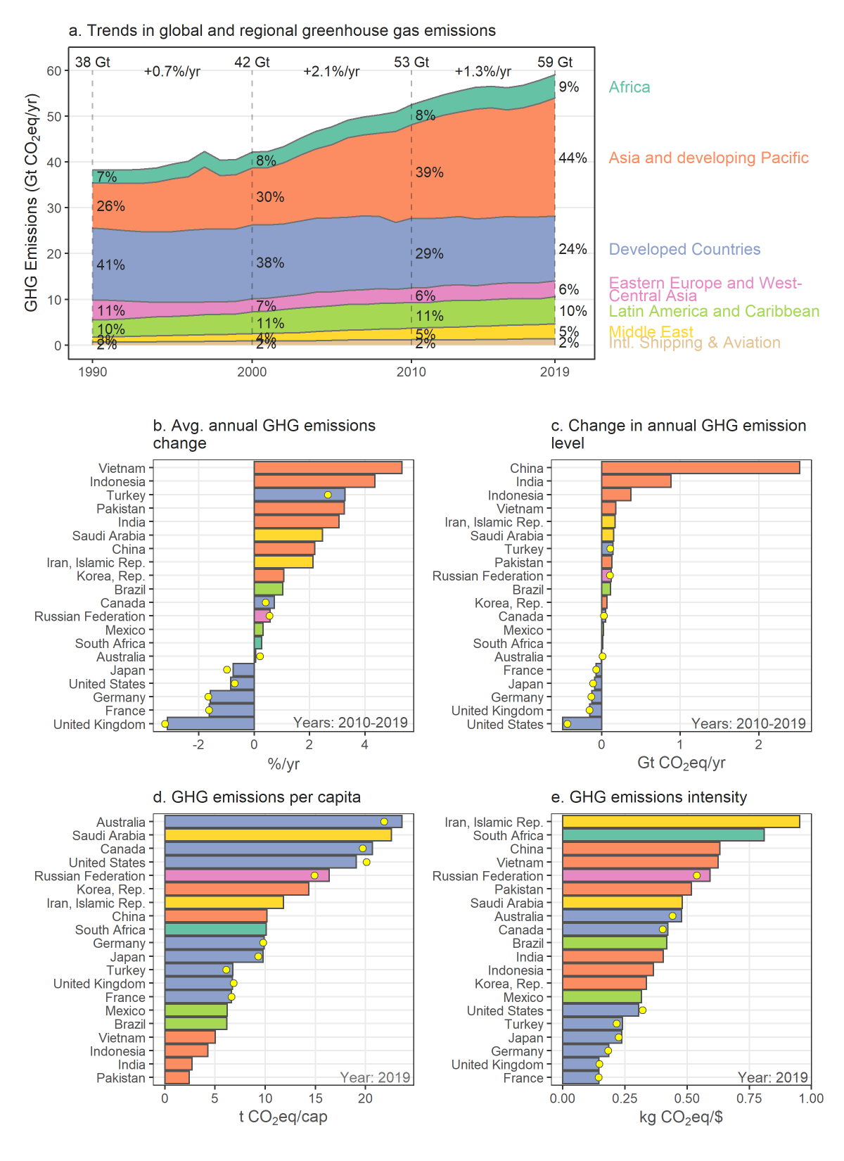
Emissions growth mainly in developing regions, starting from a lower per capita base
Minx, J. C. et al. A comprehensive dataset for global, regional and national greenhouse gas emissions by sector 1970-2019. Earth System Science Data (2021) doi:10.5194/essd-2021-228.

Slide 26
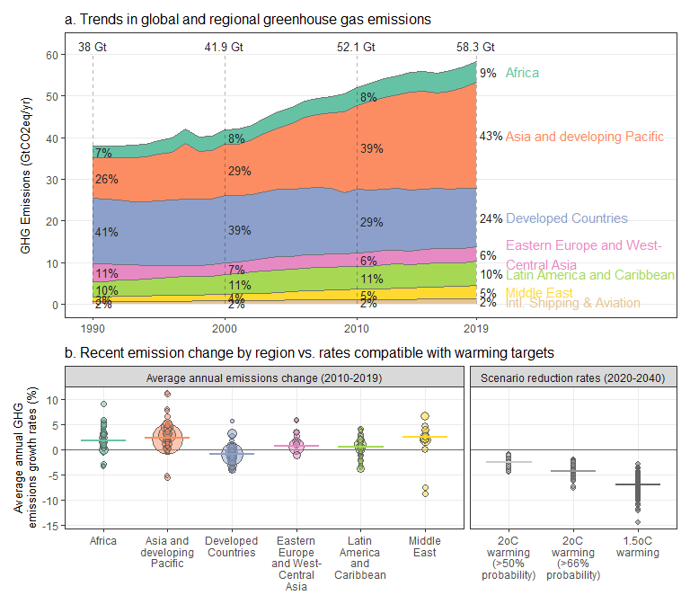
Some countries now entering an emissions reduction range equivalent to global reductions in 2oC scenarios
Based on: Minx, J. C. et al. A comprehensive dataset for global, regional and national greenhouse gas emissions by sector 1970-2019. Earth System Science Data (2021) doi:10.5194/essd-2021-228.

Slide 27
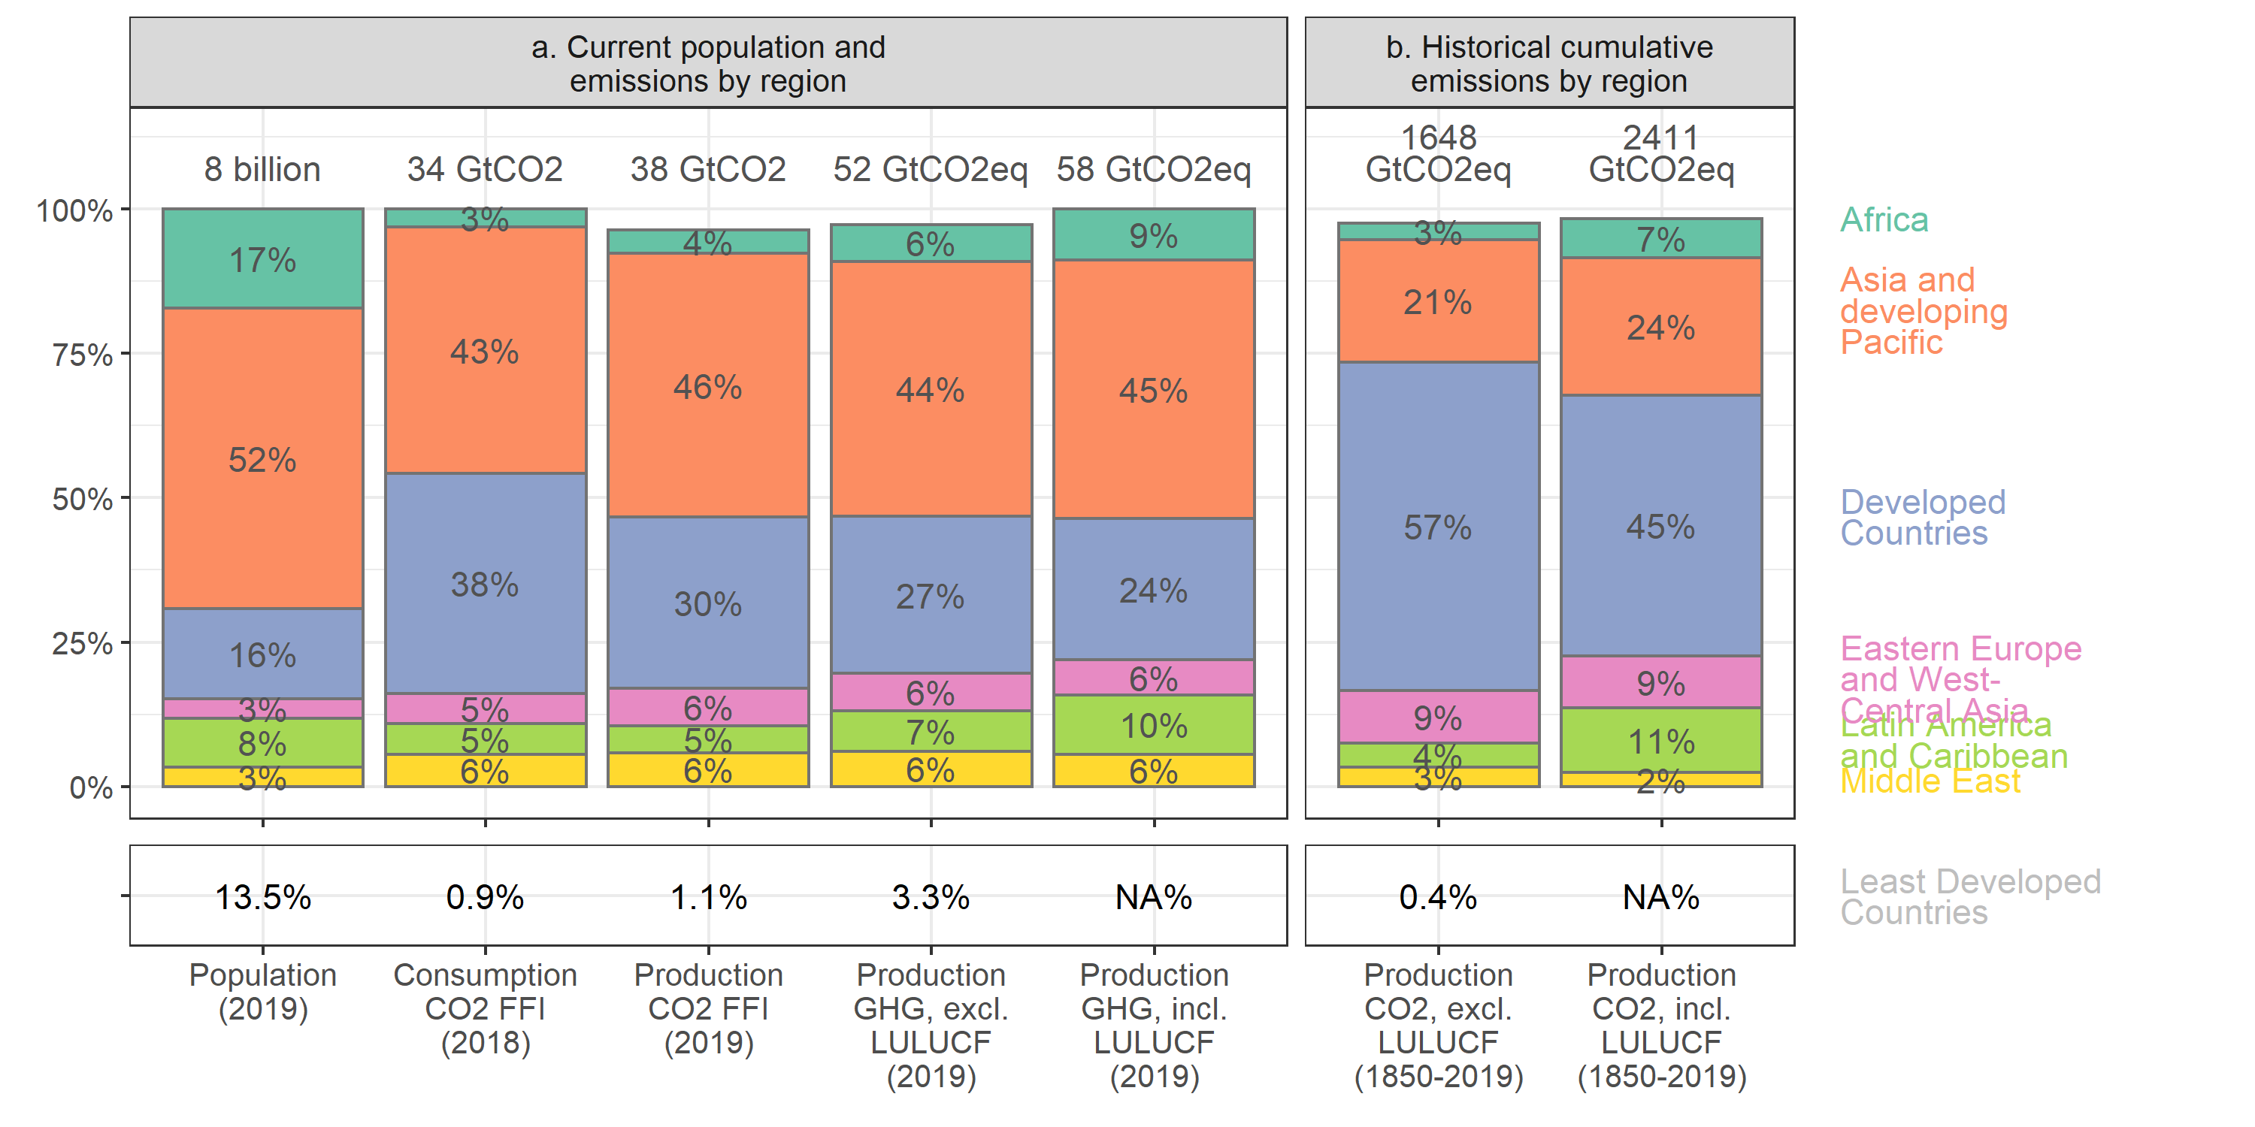
Historic emissions are dominated by developed countries Least developed countries have had a tiny impact
Based on Andrew 2021; https://folk.universitetetioslo.no/roberan/img/GCB2020/PNG/s74_2020_AlternativeRankings.png

Slide 28
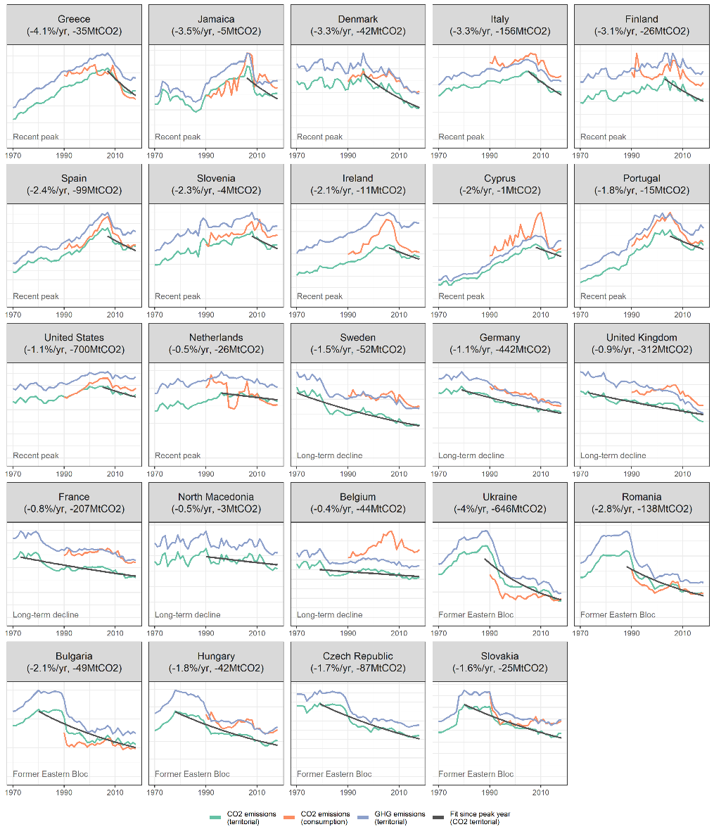
About 24 countries are reducing emissions:
Lamb, W. F., Grubb, M., Diluiso, F. & Minx, J. C. Countries with sustained greenhouse gas emissions reductions: an analysis of trends and progress by sector. Climate Policy (2021) doi:10.1080/14693062.2021.1990831

Slide 29
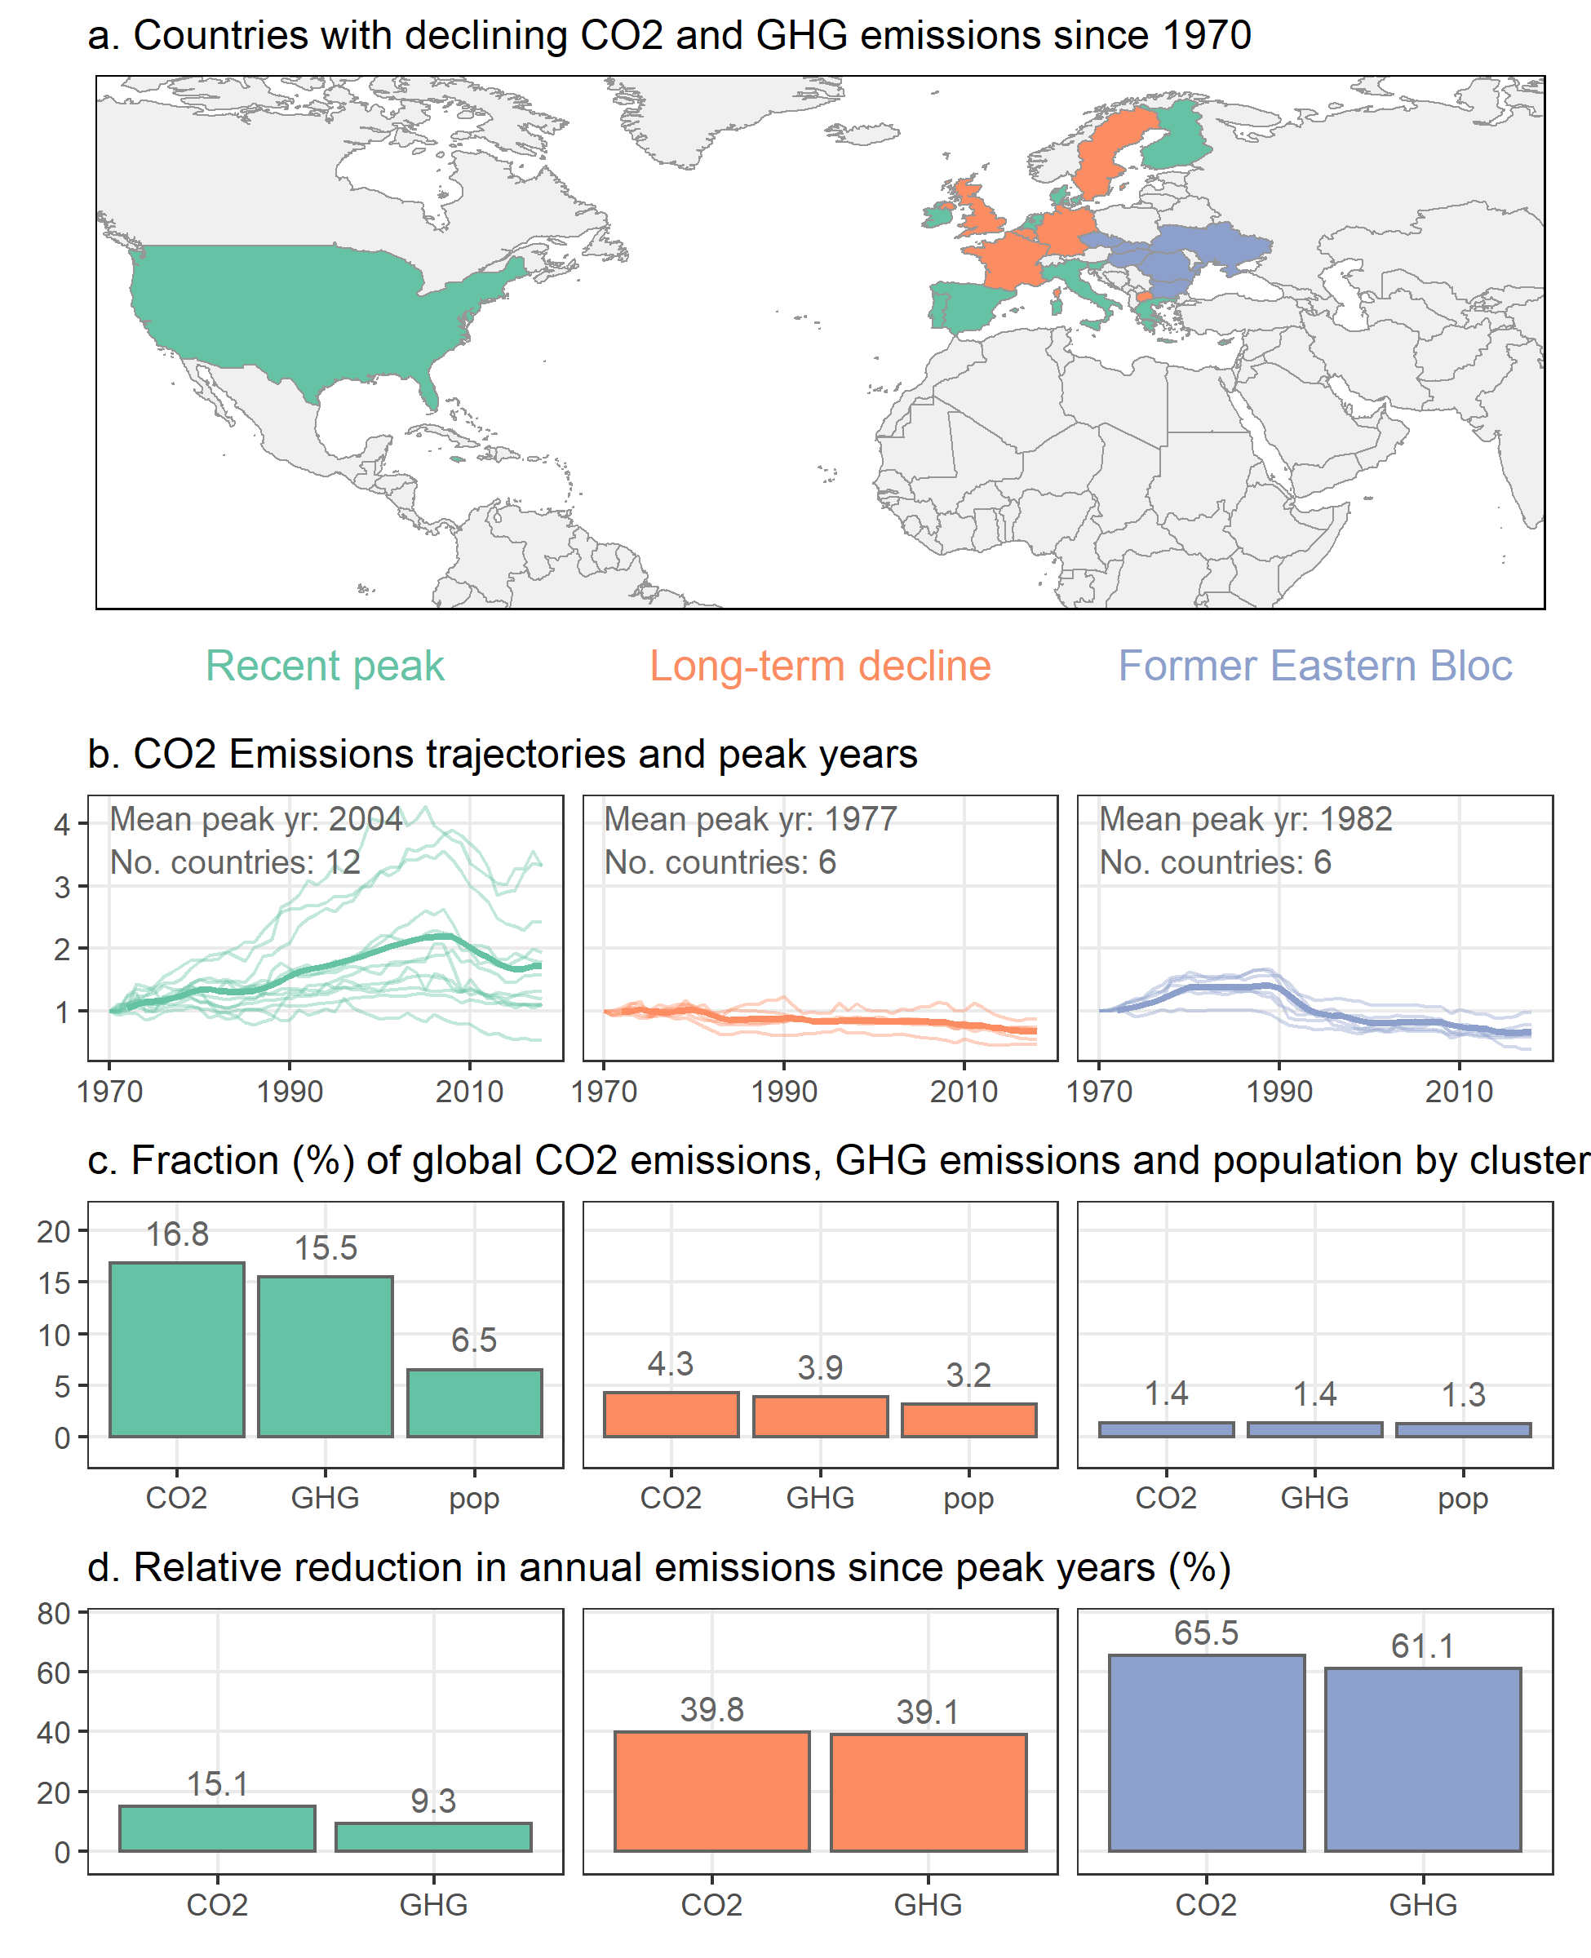
There are three types of emissions reduction pathway; the overall effect is rather low
Lamb, W. F., Grubb, M., Diluiso, F. & Minx, J. C. Countries with sustained greenhouse gas emissions reductions: an analysis of trends and progress by sector. Climate Policy (2021) doi:10.1080/14693062.2021.1990831

Slide 30
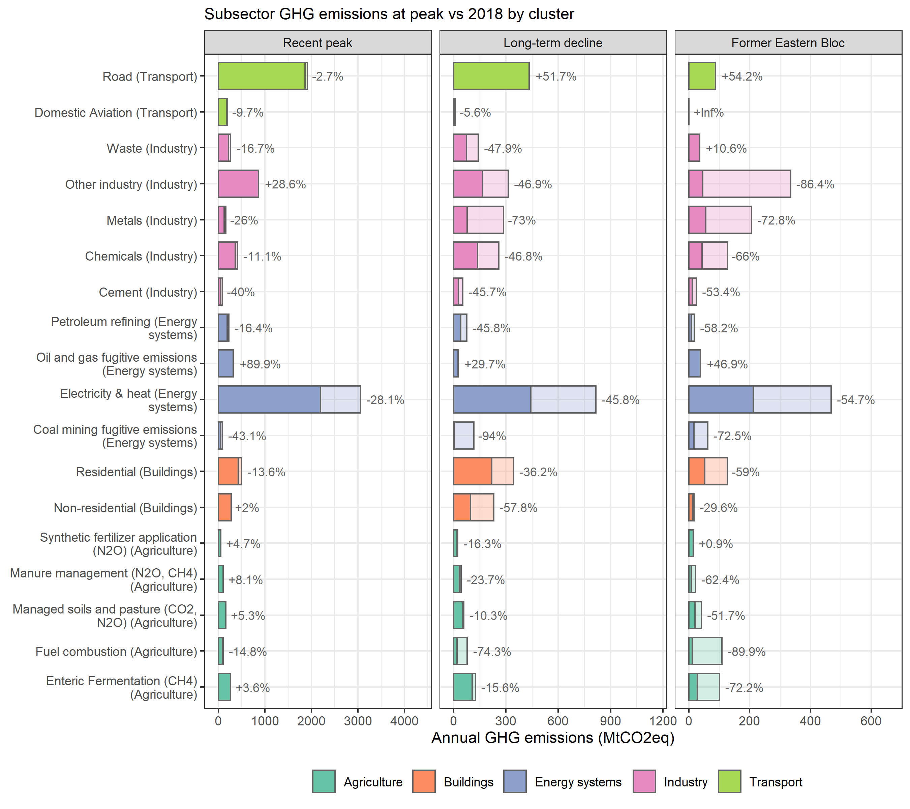
Reductions were mainly realized in the energy systems sector
Lamb, W. F., Grubb, M., Diluiso, F. & Minx, J. C. Countries with sustained greenhouse gas emissions reductions: an analysis of trends and progress by sector. Climate Policy (2021) doi:10.1080/14693062.2021.1990831

Slide 31
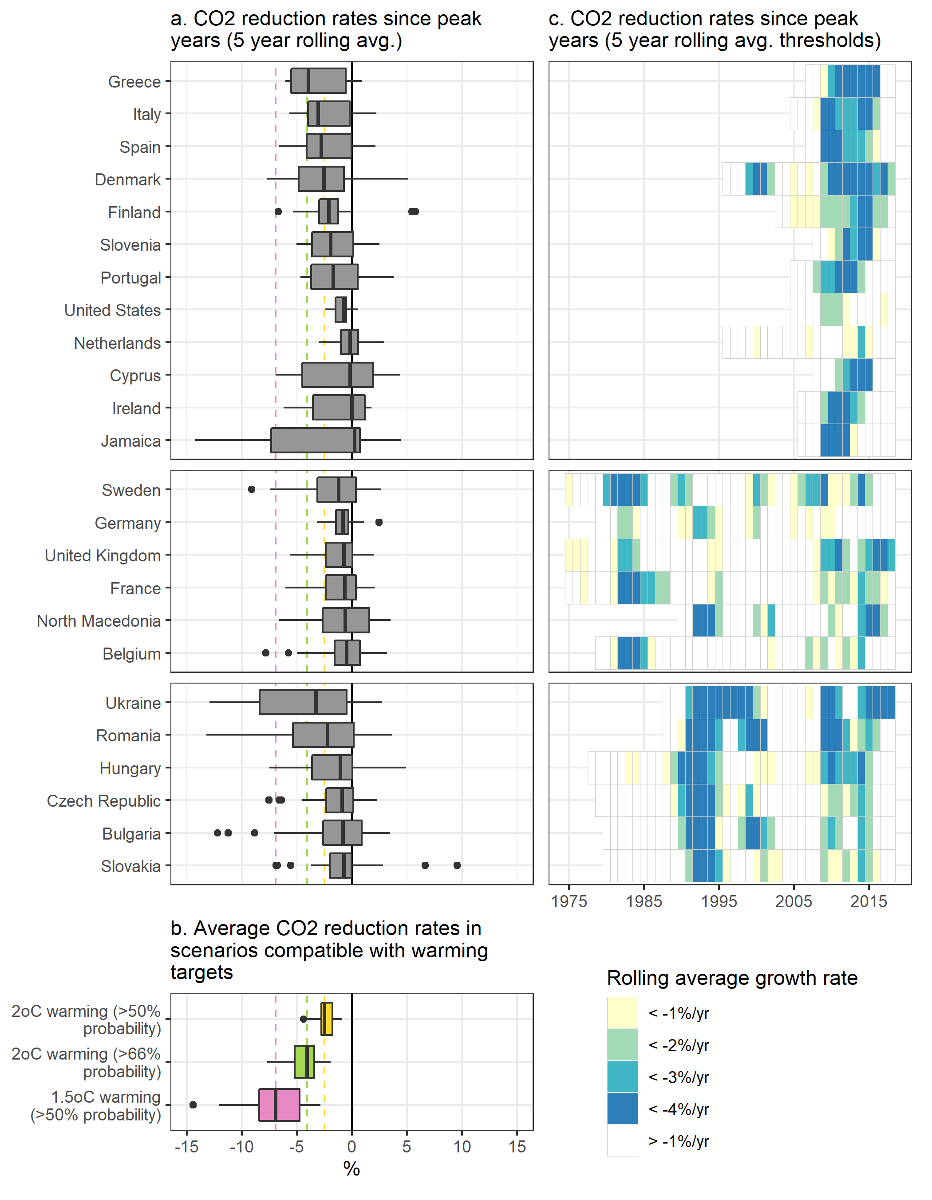
Reductions in some countries, in some years, were fast But generally not consistent
Lamb, W. F., Grubb, M., Diluiso, F. & Minx, J. C. Countries with sustained greenhouse gas emissions reductions: an analysis of trends and progress by sector. Climate Policy (2021) doi:10.1080/14693062.2021.1990831

Slide 32
Sector emissions trends

Slide 33
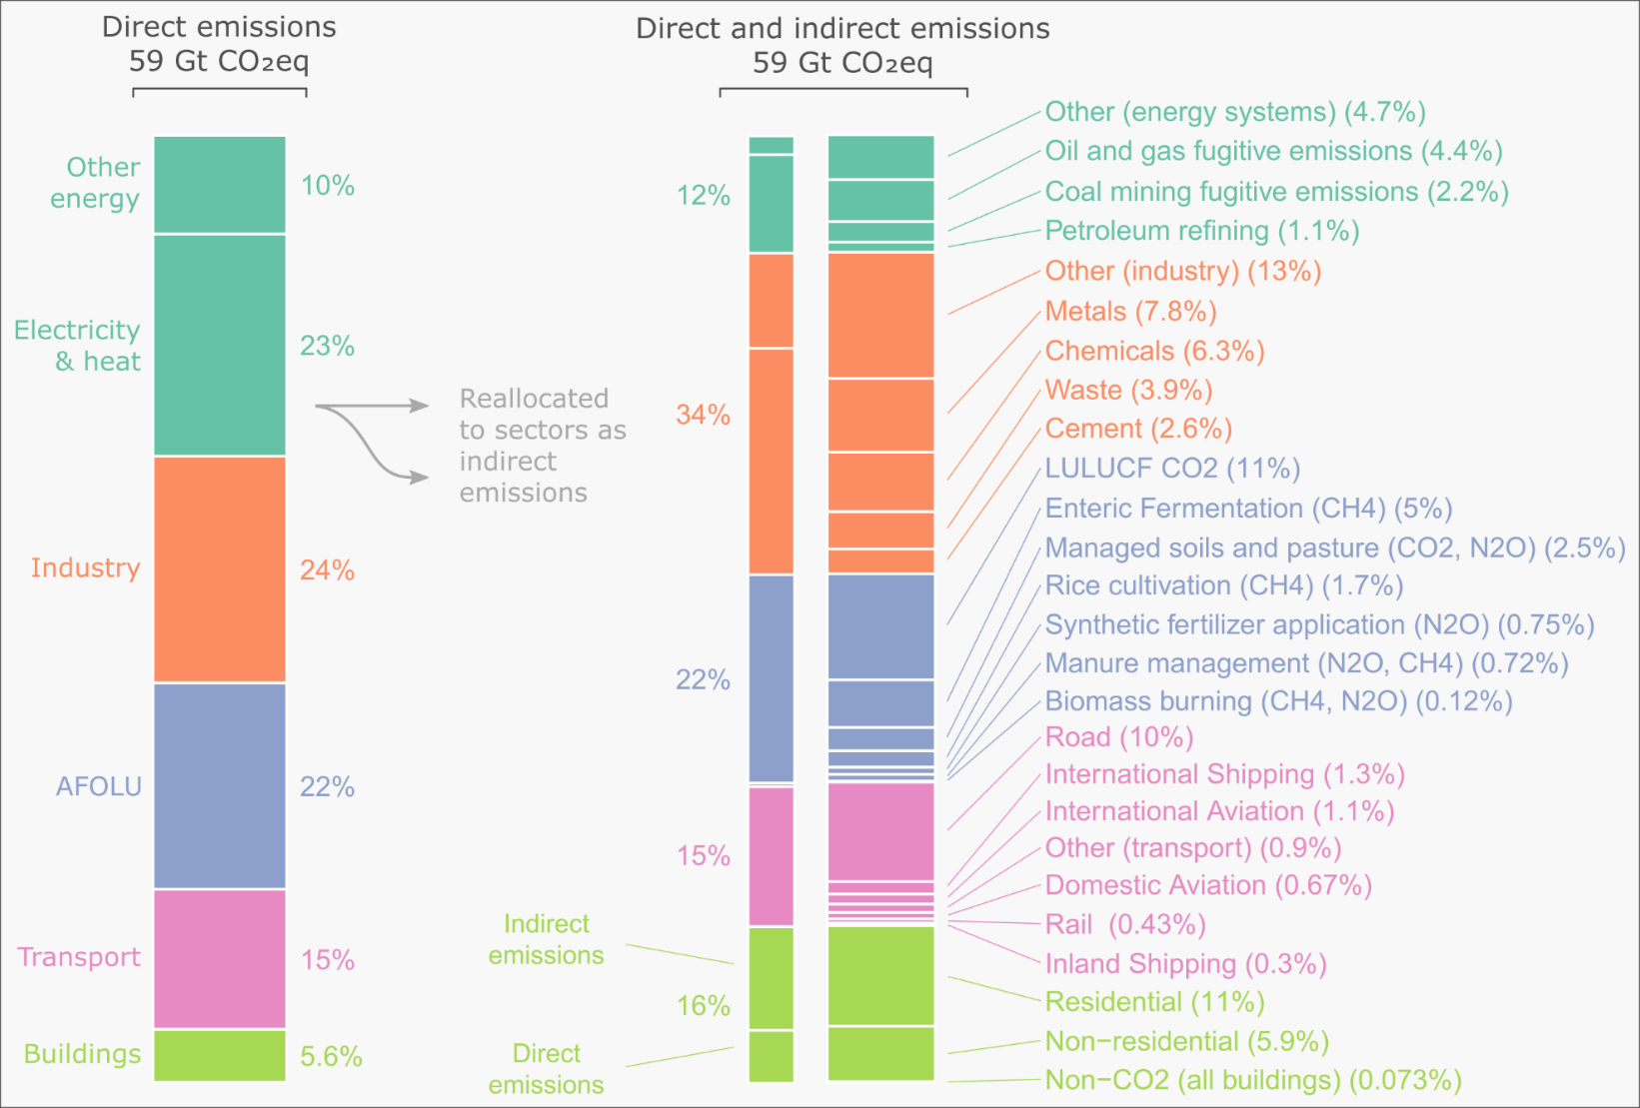
There are no single “big apples” but lots of medium apples
Lamb, W. F. et al. A review of trends and drivers of greenhouse gas emissions by sector from 1990 to 2018. Environ. Res. Lett. 16, 073005 (2021).

Slide 34
Globally, every subsector has grown since 2010
The fastest (until 2019) were:
International aviation
Domestic aviation
Shipping
Metals
Road transport
Lamb, W. F. et al. A review of trends and drivers of greenhouse gas emissions by sector from 1990 to 2018. Environ. Res. Lett. 16, 073005 (2021).

Slide 35
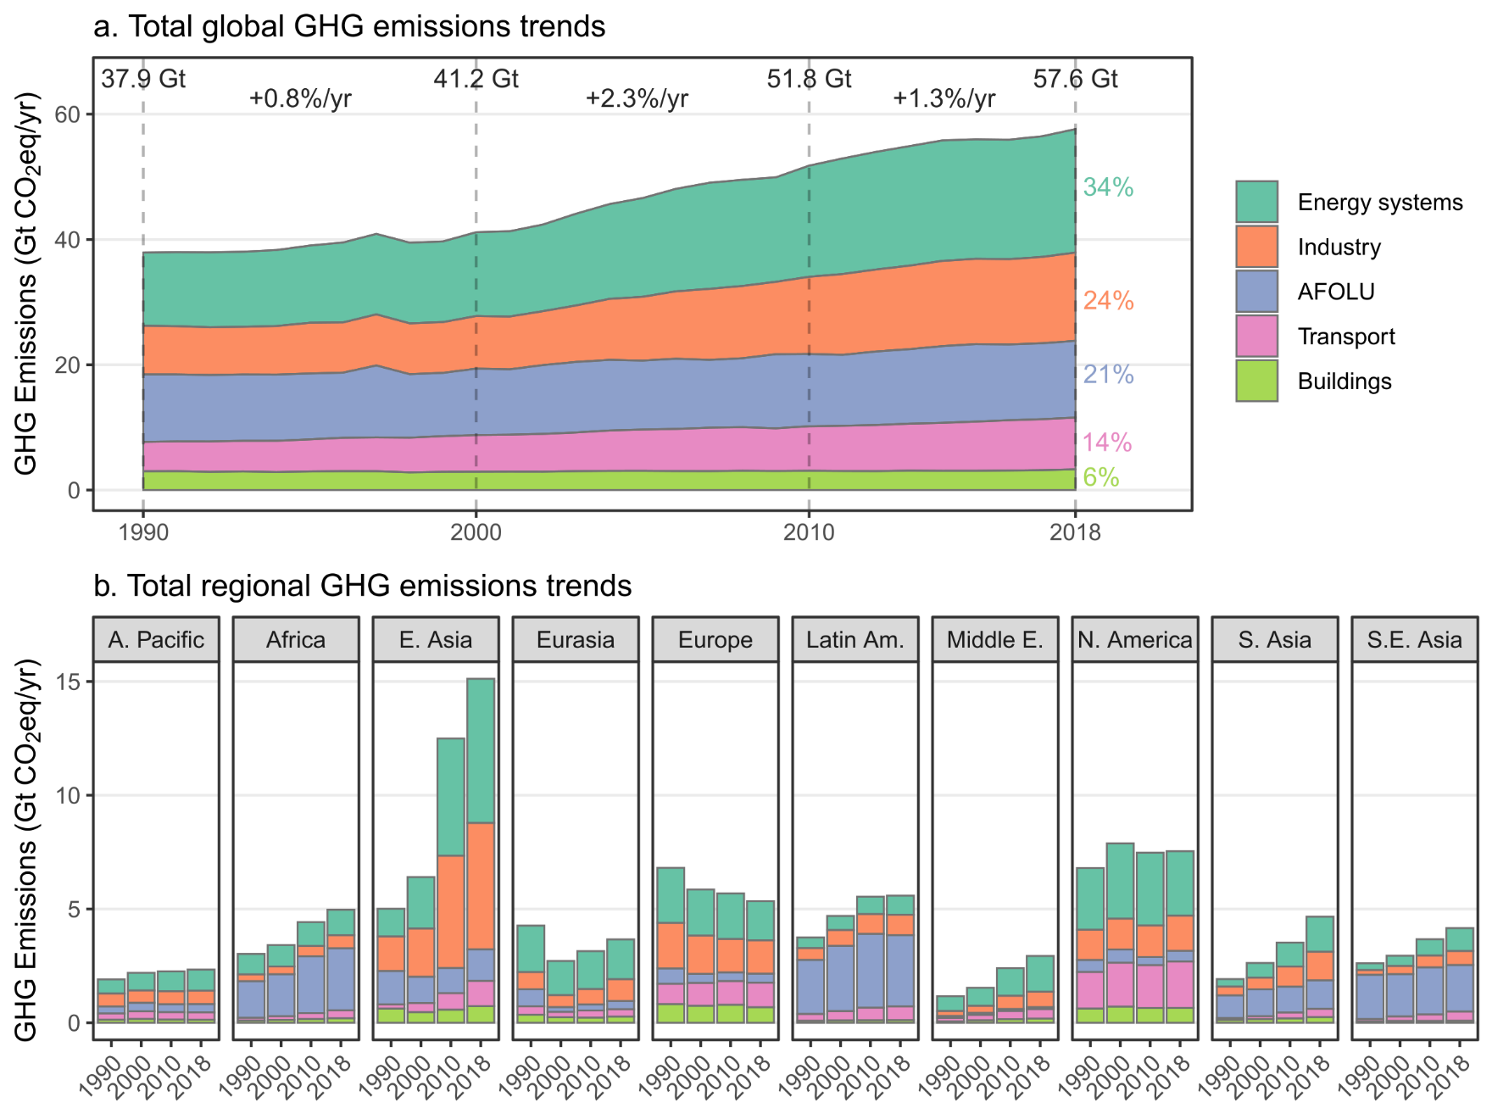
Sector emissions tend to be unequally distributed across regions
Lamb, W. F. et al. A review of trends and drivers of greenhouse gas emissions by sector from 1990 to 2018. Environ. Res. Lett. 16, 073005 (2021).

Slide 36
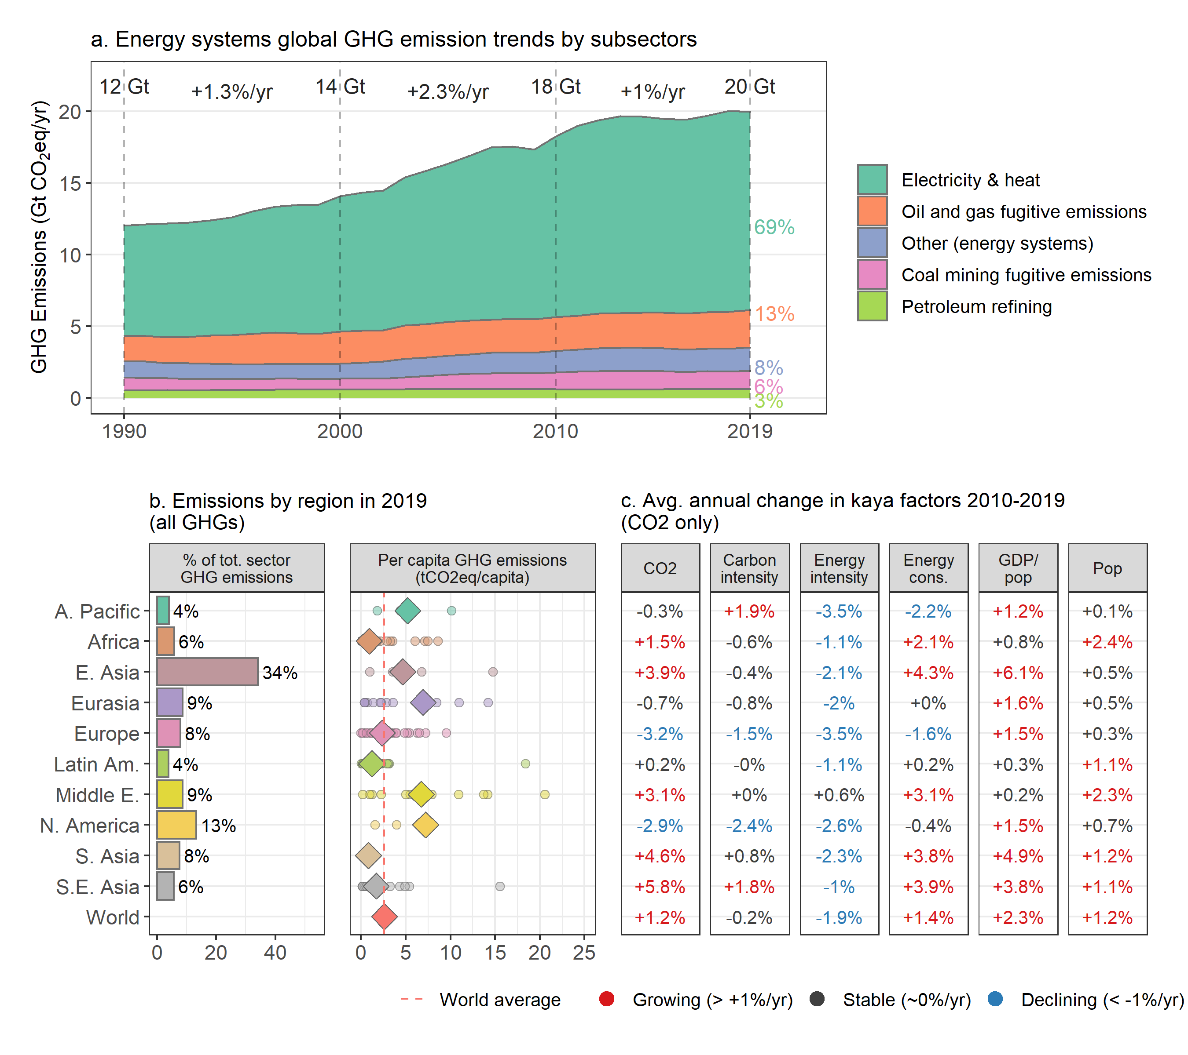
Energy system emissions growth has slowed, declining in two regions, large inequalities
Lamb, W. F. et al. A review of trends and drivers of greenhouse gas emissions by sector from 1990 to 2018. Environ. Res. Lett. 16, 073005 (2021).

Slide 37
Summary

Slide 38
Summary
Emissions are growing, but slower
Growing across all major global sectors and subsectors
Reductions somewhere outweighed by growth elsewhere
COVID emission reductions have rebounded
Some countries have already reduced by ~50%, etc.
Last 10 years of emissions = remaining 1.5 carbon budget
Uncertainties are high, we really need to invest in data and monitoring

Slide 39


Was it worth it?
Had lots of fun with Will & Niklas
Came in too late as CLA to achieve everything I would have liked to achieve -> policies
Huge opportunity to network in the field of GHG emissions
Productive time that provided also focus for the group
Important for institutions like PIK, IIASA or MCC to engage
It can be a career booster rather than a blocker
Also had fun
New collaborations
Probably was very good for my career
Interesting to observe the process, and good for generating ideas
We had rather a high pressure role, hopefully no horrific mistakes were made…

Slide 40
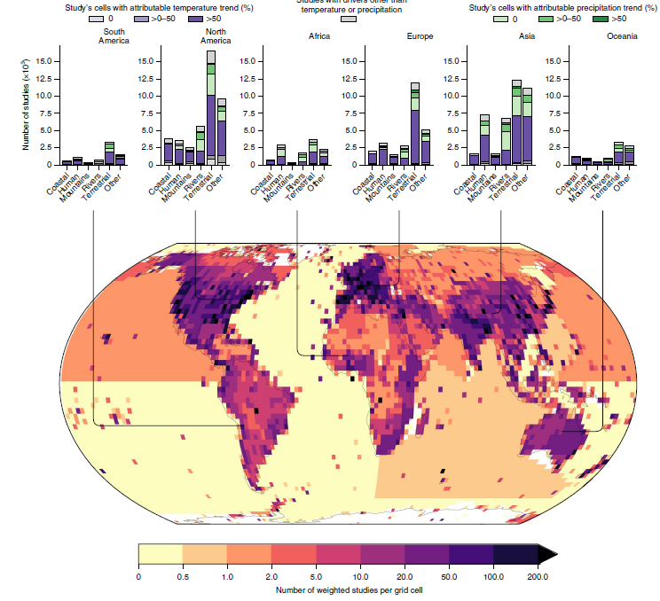
Future developments
Commentary with Montreal Protocol people: the importance and policy neglect and divide of f-gases in climate policy (with Matt Rigby)
Substantive piece on warming contributions by countries/regions – linked with our work on climate impacts (with Piers Forster)
Piece on equity issues focussing on least developed countries (with Shonali Pachauri)

Slide 41

An annual MCC-led publication on global GHG emissions by country and sector?

Slide 42
Thanks!
Jan C. Minx
mail minx@mcc-berlin.net
William F. Lamb
mail lamb@mcc-berlin.net
MCC was founded jointly by Stiftung Mercator and
the Potsdam Institute for Climate Impact Research

